Slide 1
Xsell - sports

Slide 2
Criteria
Customer is target when:
Was playing casino, poker or both in the past
Started to play sports at some point
Successfully spent non bonus money on sports

Slide 3
Features
CL360_Bio_Mart
CL360_Casino_Mart
CL360_Poker_360
Unica
LTV2.0 (LTV for 365 days)

Slide 4
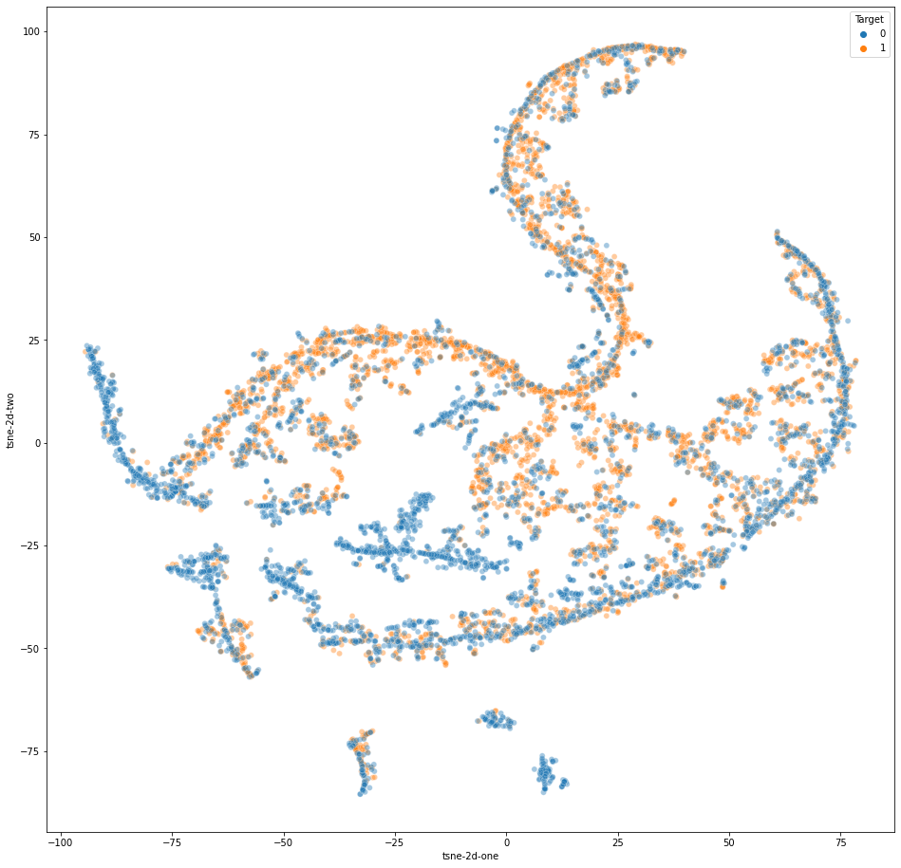
Embedding of the problem

Slide 5
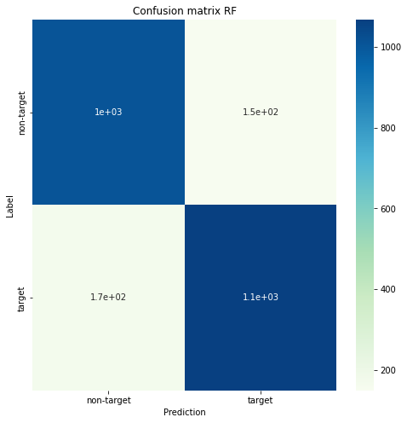
Simple RF classifier
Accuracy: 0.87 Precision: 0.87 Recall: 0.87 f1_score: 0.87

Slide 6
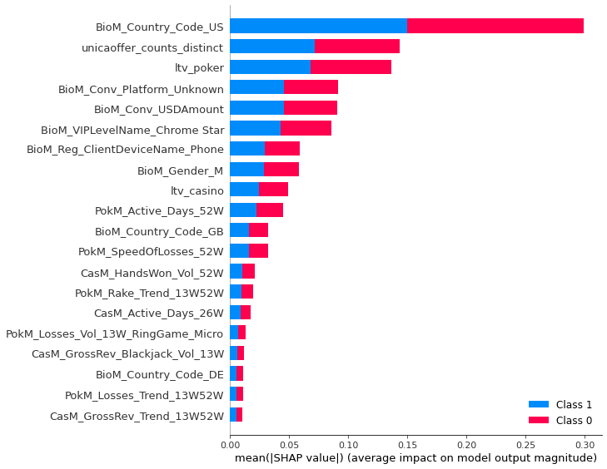
Feature Importance

Slide 7
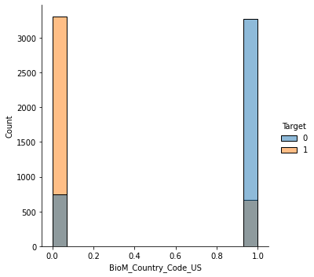
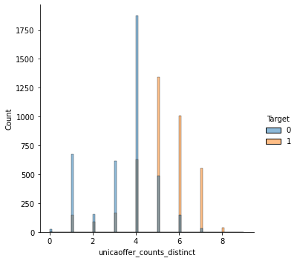
Feature Importance
Notes:
US customers are not target
Customers with more distinct offers are targets

Slide 8
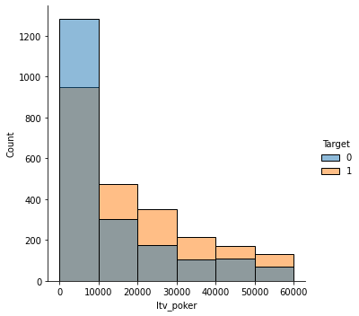
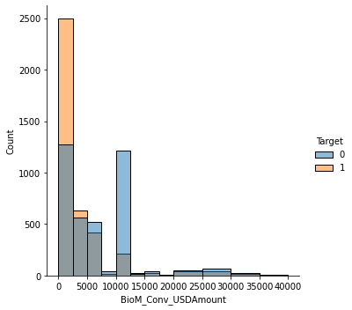
Feature Importance
Notes:
Targets spends more on poker, not valid for the first interval

Slide 9
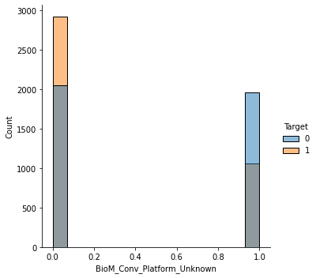
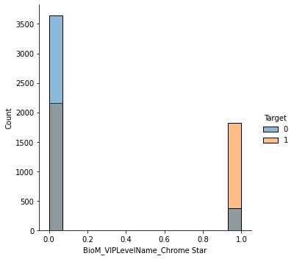
Feature Importance
Notes:
If device is unknow, less likely to give promotions

Slide 10
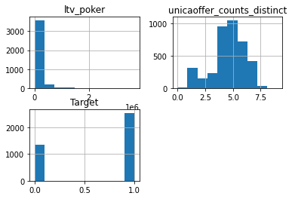
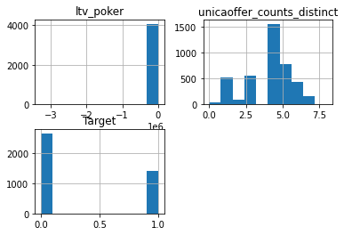
LTV poker vs unique unica offers
Ltv > 100 usd (avg 4.6 unique camp)
Ltv <= 100 usd (avg 3.9 unique camp)
Notes:
If device is unknow, less likely to give promotions

Slide 11
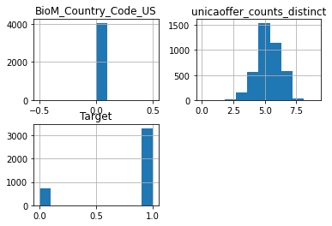
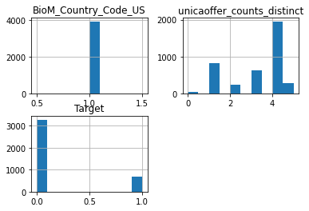
Just US customers
Notes:
Us customers are not receiving as many unica offers

Slide 12
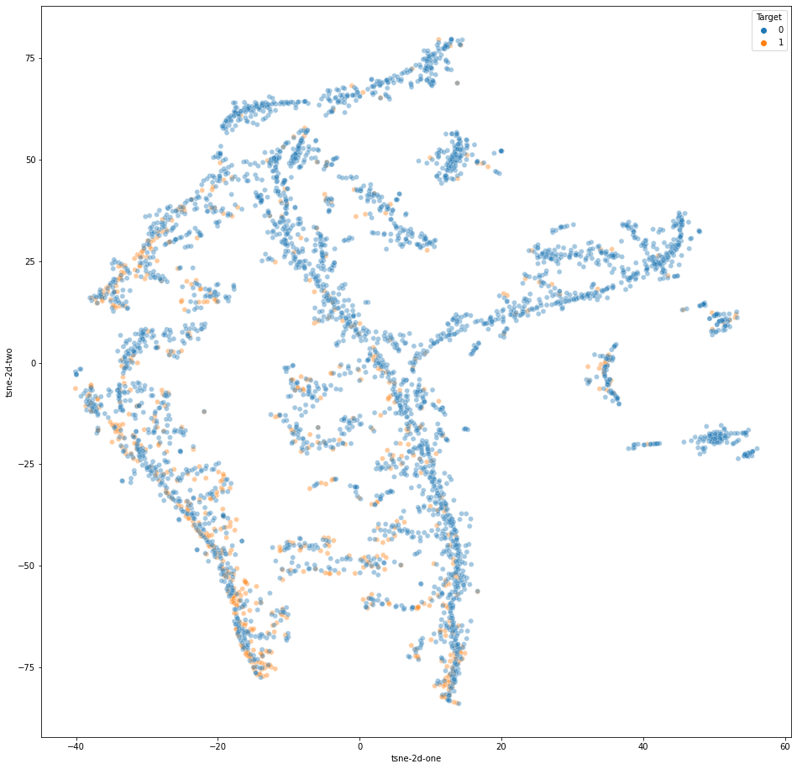
Just US customers

Slide 13
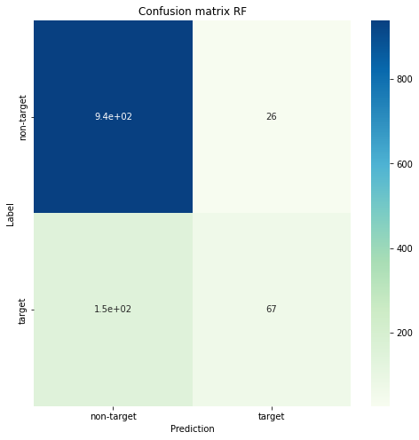
Just US customers
Notes:
Can easily see the non targets and somehow see the targets

Slide 14
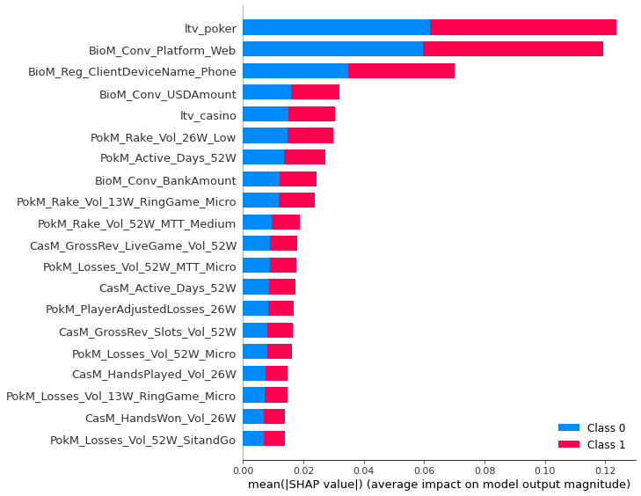
Just US customers
Notes:
Rely on poker ltv, plataform web and phone device

Slide 15
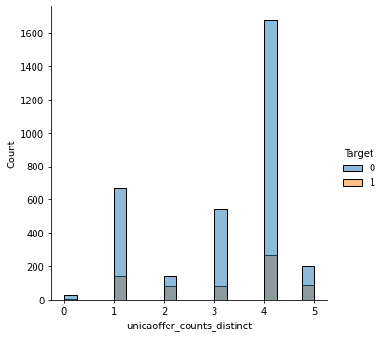
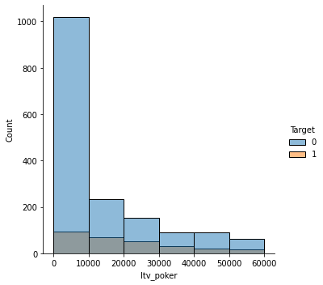
Just US customers

Slide 16
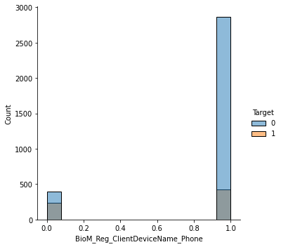
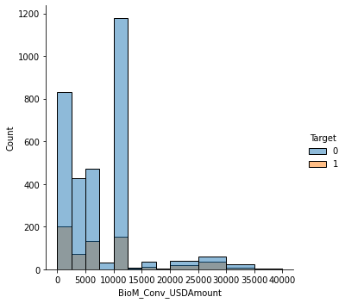
Just US customers

Slide 17
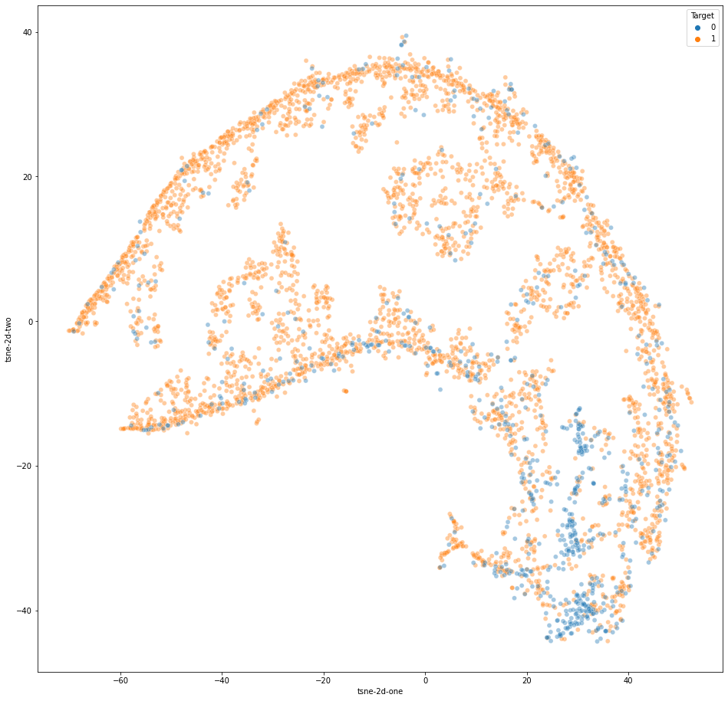
Non-US customers

Slide 18
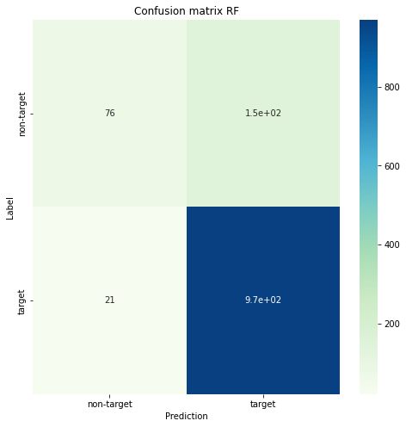
Non-US customers

Slide 19
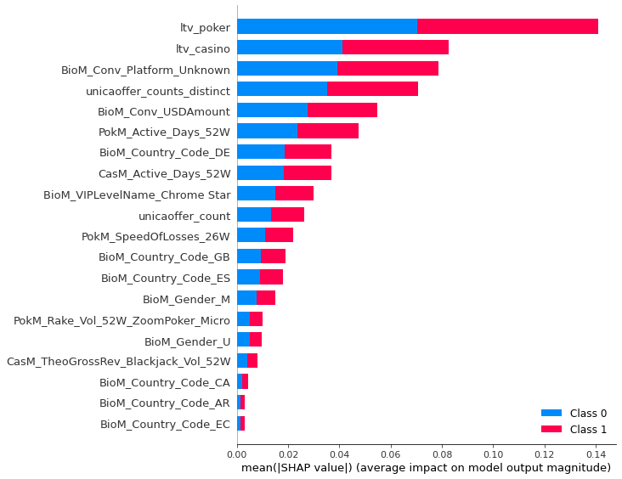
Non-US customers

Slide 20
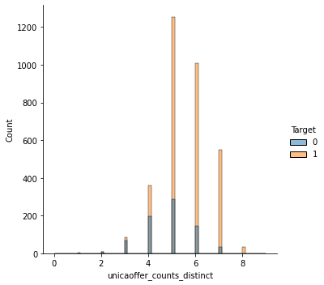
Non-US customers

Slide 21
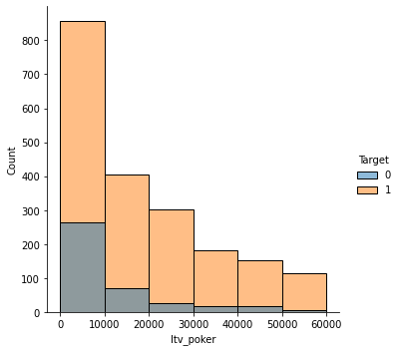
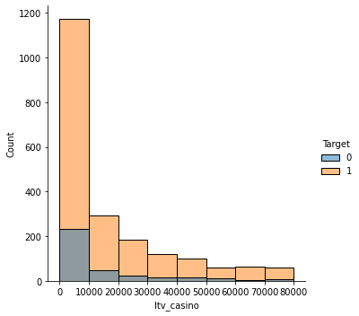
Non-US customers

Slide 22
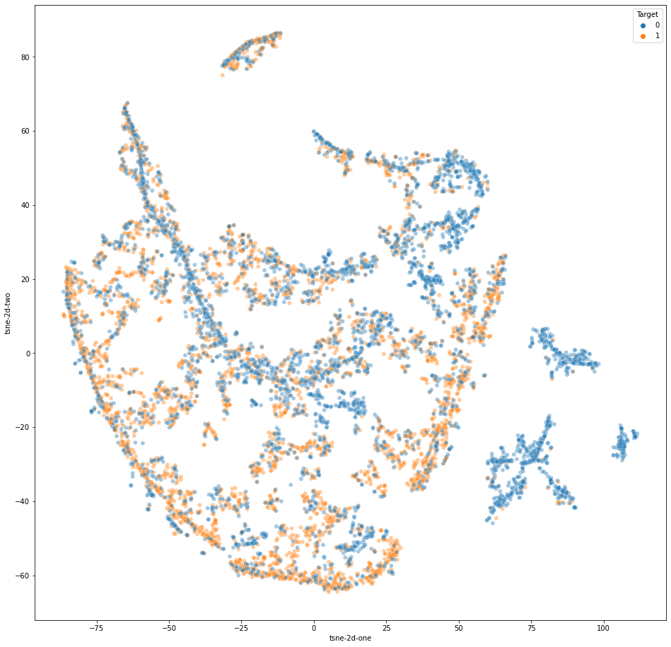
No country information

Slide 23
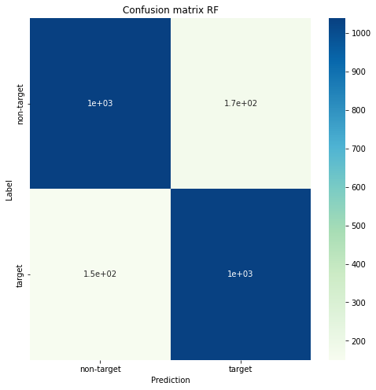
No country information

Slide 24
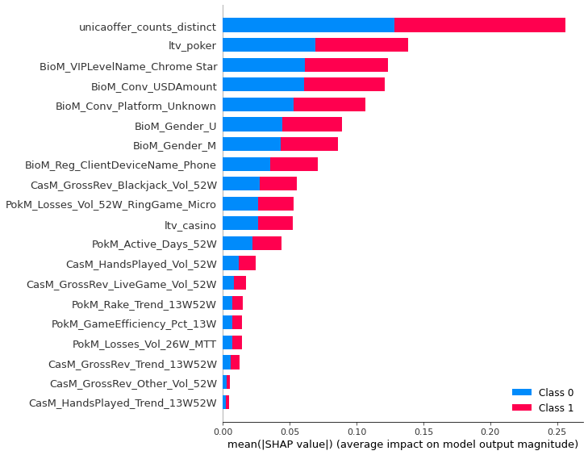
No country information

Slide 25
No country information
Notes:
Target are customers who received different unica offers and customer who are spending more into poker

Slide 26
Conclusions
US customers are receiving less different unica offers.
US customers, are less likely to cross sell. It can be because of unica offers.
LTV in poker plays a role. Higher the LTV in poker, more likely is the customer to cross sell.
Higher LTV customers receive more different unica offers. But the difference is not that big (4.6 vs 3.9).
Depending on the demography, features like device, have some importance.
Further investigation need to occur, specially to see why us customers are receiving less unica offers.
Notes:
Target are customers who received different unica offers and customer who are spending more into poker

Slide 27
Thank You

